Slide 1

Can 2.5 PPT Template
4:3 presentation pack
Edit Master text styles

Slide 2
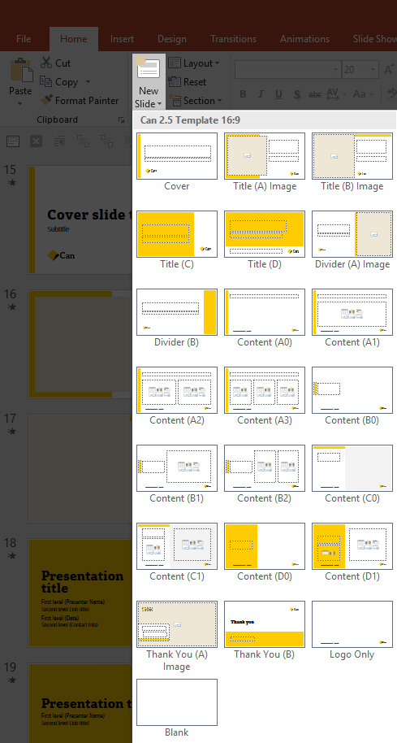
Inserting a new layout
Slide layouts have been set up in this template.
These layouts will assist in laying out content easily and also maintaining consistency across presentations.
Inserting a new slide layout
Go to Home > Slides > New Slide.
Select the best layout suited for the content.
Slide layout will be inserted.

Slide 3
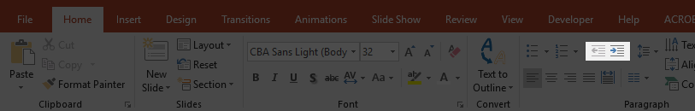
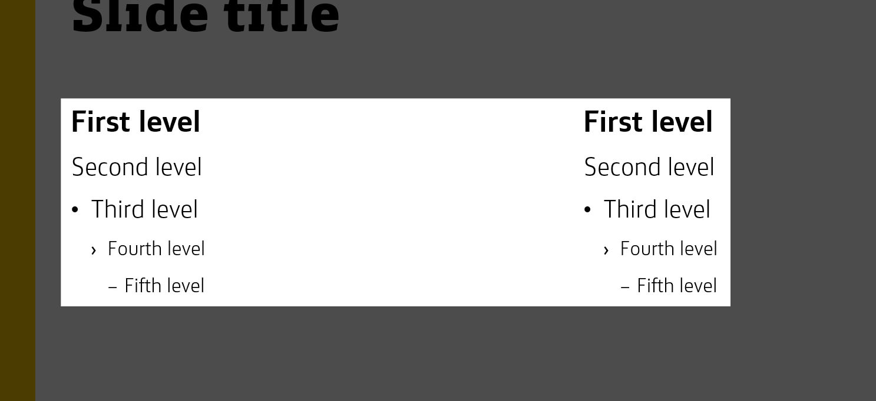
Text list level
Using text list level
Use the Decrease and Increase List Level buttons from the Home tab to ensure consistent formatting.
This applies to all layouts with text and content placeholders.
Please make sure to use list levels to apply proper bullet points.
Levels of text styles available

Slide 4
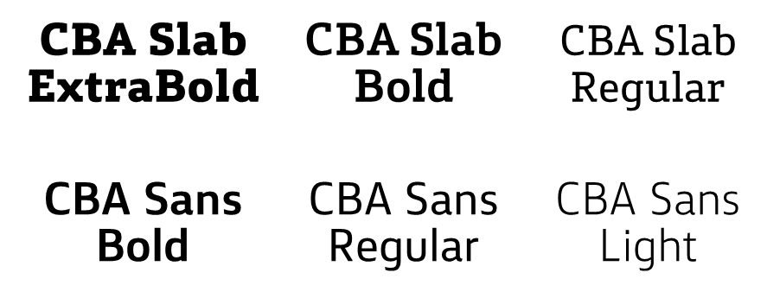
Text format
Ensure the minimum font size is 20pt for on-screen presentations.
Avoid excessive use of formatting, such as bold, italic and underline.
Avoid use of CAPITALISED TEXT.
Avoid the use of justified text alignment.
TIP:
If using this document as a report style make the heading 24pt, subtitles 18pt and body copy 10pt; or use the A4 portrait/landscape template.
For heading
For subheading
For body text

Slide 5


Slide examples Title slides
Title (A) Image layout
Title (B) Image layout

Slide 6

Slide examples Divider slide
Divider (A) Image layout

Slide 7
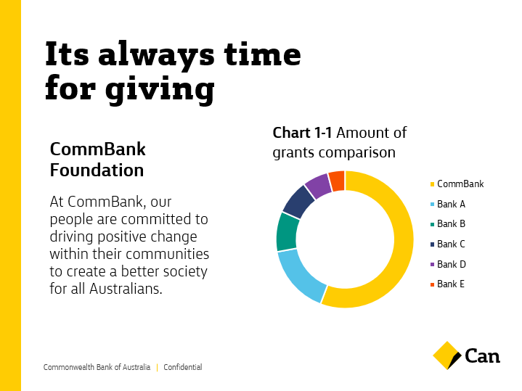
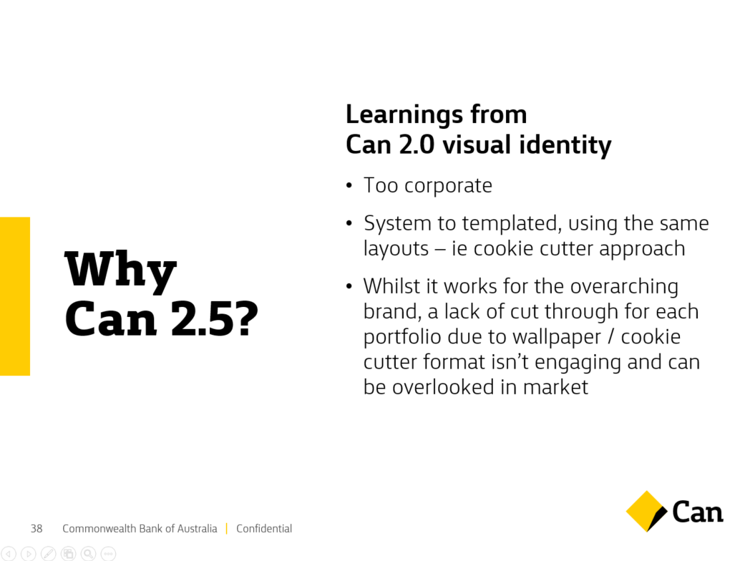
Slide examples Content slides
Content (A0) layout
Content (B1) layout

Slide 8

Slide examples Content slides
Content (B1) layout

Slide 9


Slide examples Content slides
Thank You (A) Image layout
Thank You (B) layout

Slide 10
Introduction to MongoDB
Subtitle

Slide 11
Presentation title
Kevin Au
Enterprise Services Graduate
Date
Contact info

Slide 12
Presentation title
Presenter name
Job title here
Date
Contact info

Slide 13
Presentation title
First level (Presenter name)
Second level (Job title)
First level (Date)
Second level (Contact Info)

Slide 14
Presentation title
First level (Presenter Name)
Second level (Job title)
First level (Date)
Second level (Contact info)

Slide 15
Divider slide title
Subtitle

Slide 16
Divider slide title
Subtitle

Slide 17
Agenda
First level
Second level
First level
Second level
First level
Second level
First level
Second level
First level
Second level
First level
Second level

Slide 18
Agenda
First level
Second level
First level
Second level
First level
Second level
First level
Second level
First level
Second level
First level
Second level
First level
Second level
First level
Second level

Slide 19
Slide title
Slide subtitle

Slide 20
Slide title
Slide subtitle
First level
Second level
Third level
Fourth level

Slide 21
Slide title
Slide subtitle
First level
Second level
Third level
Fourth level
Fifth level
First level
Second level
Third level
Fourth level
Fifth level

Slide 22
Slide title
Slide subtitle
First level
Second level
Third level
Fourth level
Fifth level
First level
Second level
Third level
Fourth level
Fifth level
First level
Second level
Third level
Fourth level
Fifth level

Slide 23
Slide title
Slide subtitle

Slide 24
Slide title
First level
Second level
Third level
Fourth level
Fifth level
Slide subtitle

Slide 25
Slide title
First level
Second level
Third level
Fourth level
Fifth level
First level
Second level
Third level
Fourth level
Fifth level
Slide subtitle

Slide 26
Slide title
Slide subtitle

Slide 27
Slide title
First level
Second level
Third level
Fourth level
Fifth level
Slide subtitle
First level
Second level
Third level
Fourth level
Fifth level

Slide 28
Slide title
Slide subtitle

Slide 29
Slide title
First level
Second level
Third level
Fourth level
Fifth level
Slide subtitle
First level
Second level
Third level
Fourth level
Fifth level

Slide 30
Slide title
First level
Second level
Third level
Fourth level
Fifth level
First level
Second level
Third level
Fourth level
Fifth level
Slide subtitle
First level
Second level
Third level
Fourth level
Fifth level

Slide 31
Disclaimer
Disclaimer body heading
Disclaimer text

Slide 32
CTA title
Edit Master text styles
Second level
Third level
Fourth level
2 line disclaimer

Slide 33
Thank you
Presenter name
Email / phone

Slide 34
Thank you
First level (Name)
Second level (Email / Phone)

Slide 35
Thank you
First level (Name)
Second level (Email / Phone)

Slide 36
Chart example
Stacked column

Slide 37
Chart example
Clustered column

Slide 38
Chart example
Line

Slide 39
Chart example
Donut

Slide 40
Table example
Table 1-1 Table title
Title | Header 1 | Header 2 | Header 3
Item 1 | Text | Text | Text
Item 2 | Text | Text | Text
Item 3 | Text | Text | Text
Item 4 | Text | Text | Text
Total | Text | Text | Text

